Slide 1
(IMDCGD214-16YRD) Level 4/5 Group 15
Elliot Page Ben Reynolds Roberto Mitrea

Slide 2
Brief
For 2 players
Physics based
Adversarial
(i.e. “...characterised by conflict or opposition” – Oxford Dictionary)
On a single device
(i.e. No hidden information)

Slide 3
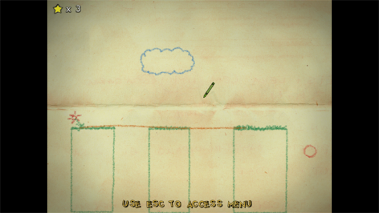
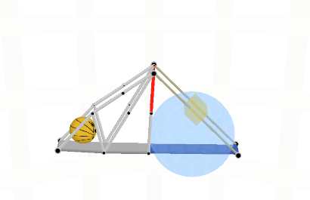
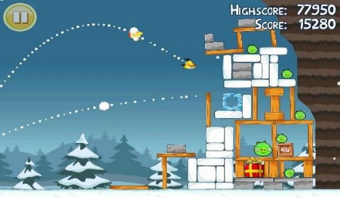
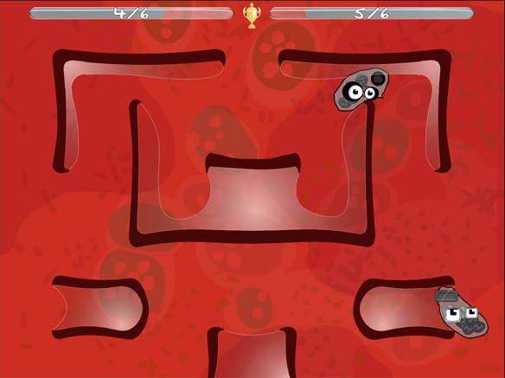
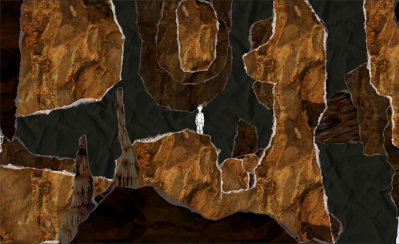
Research

Slide 4
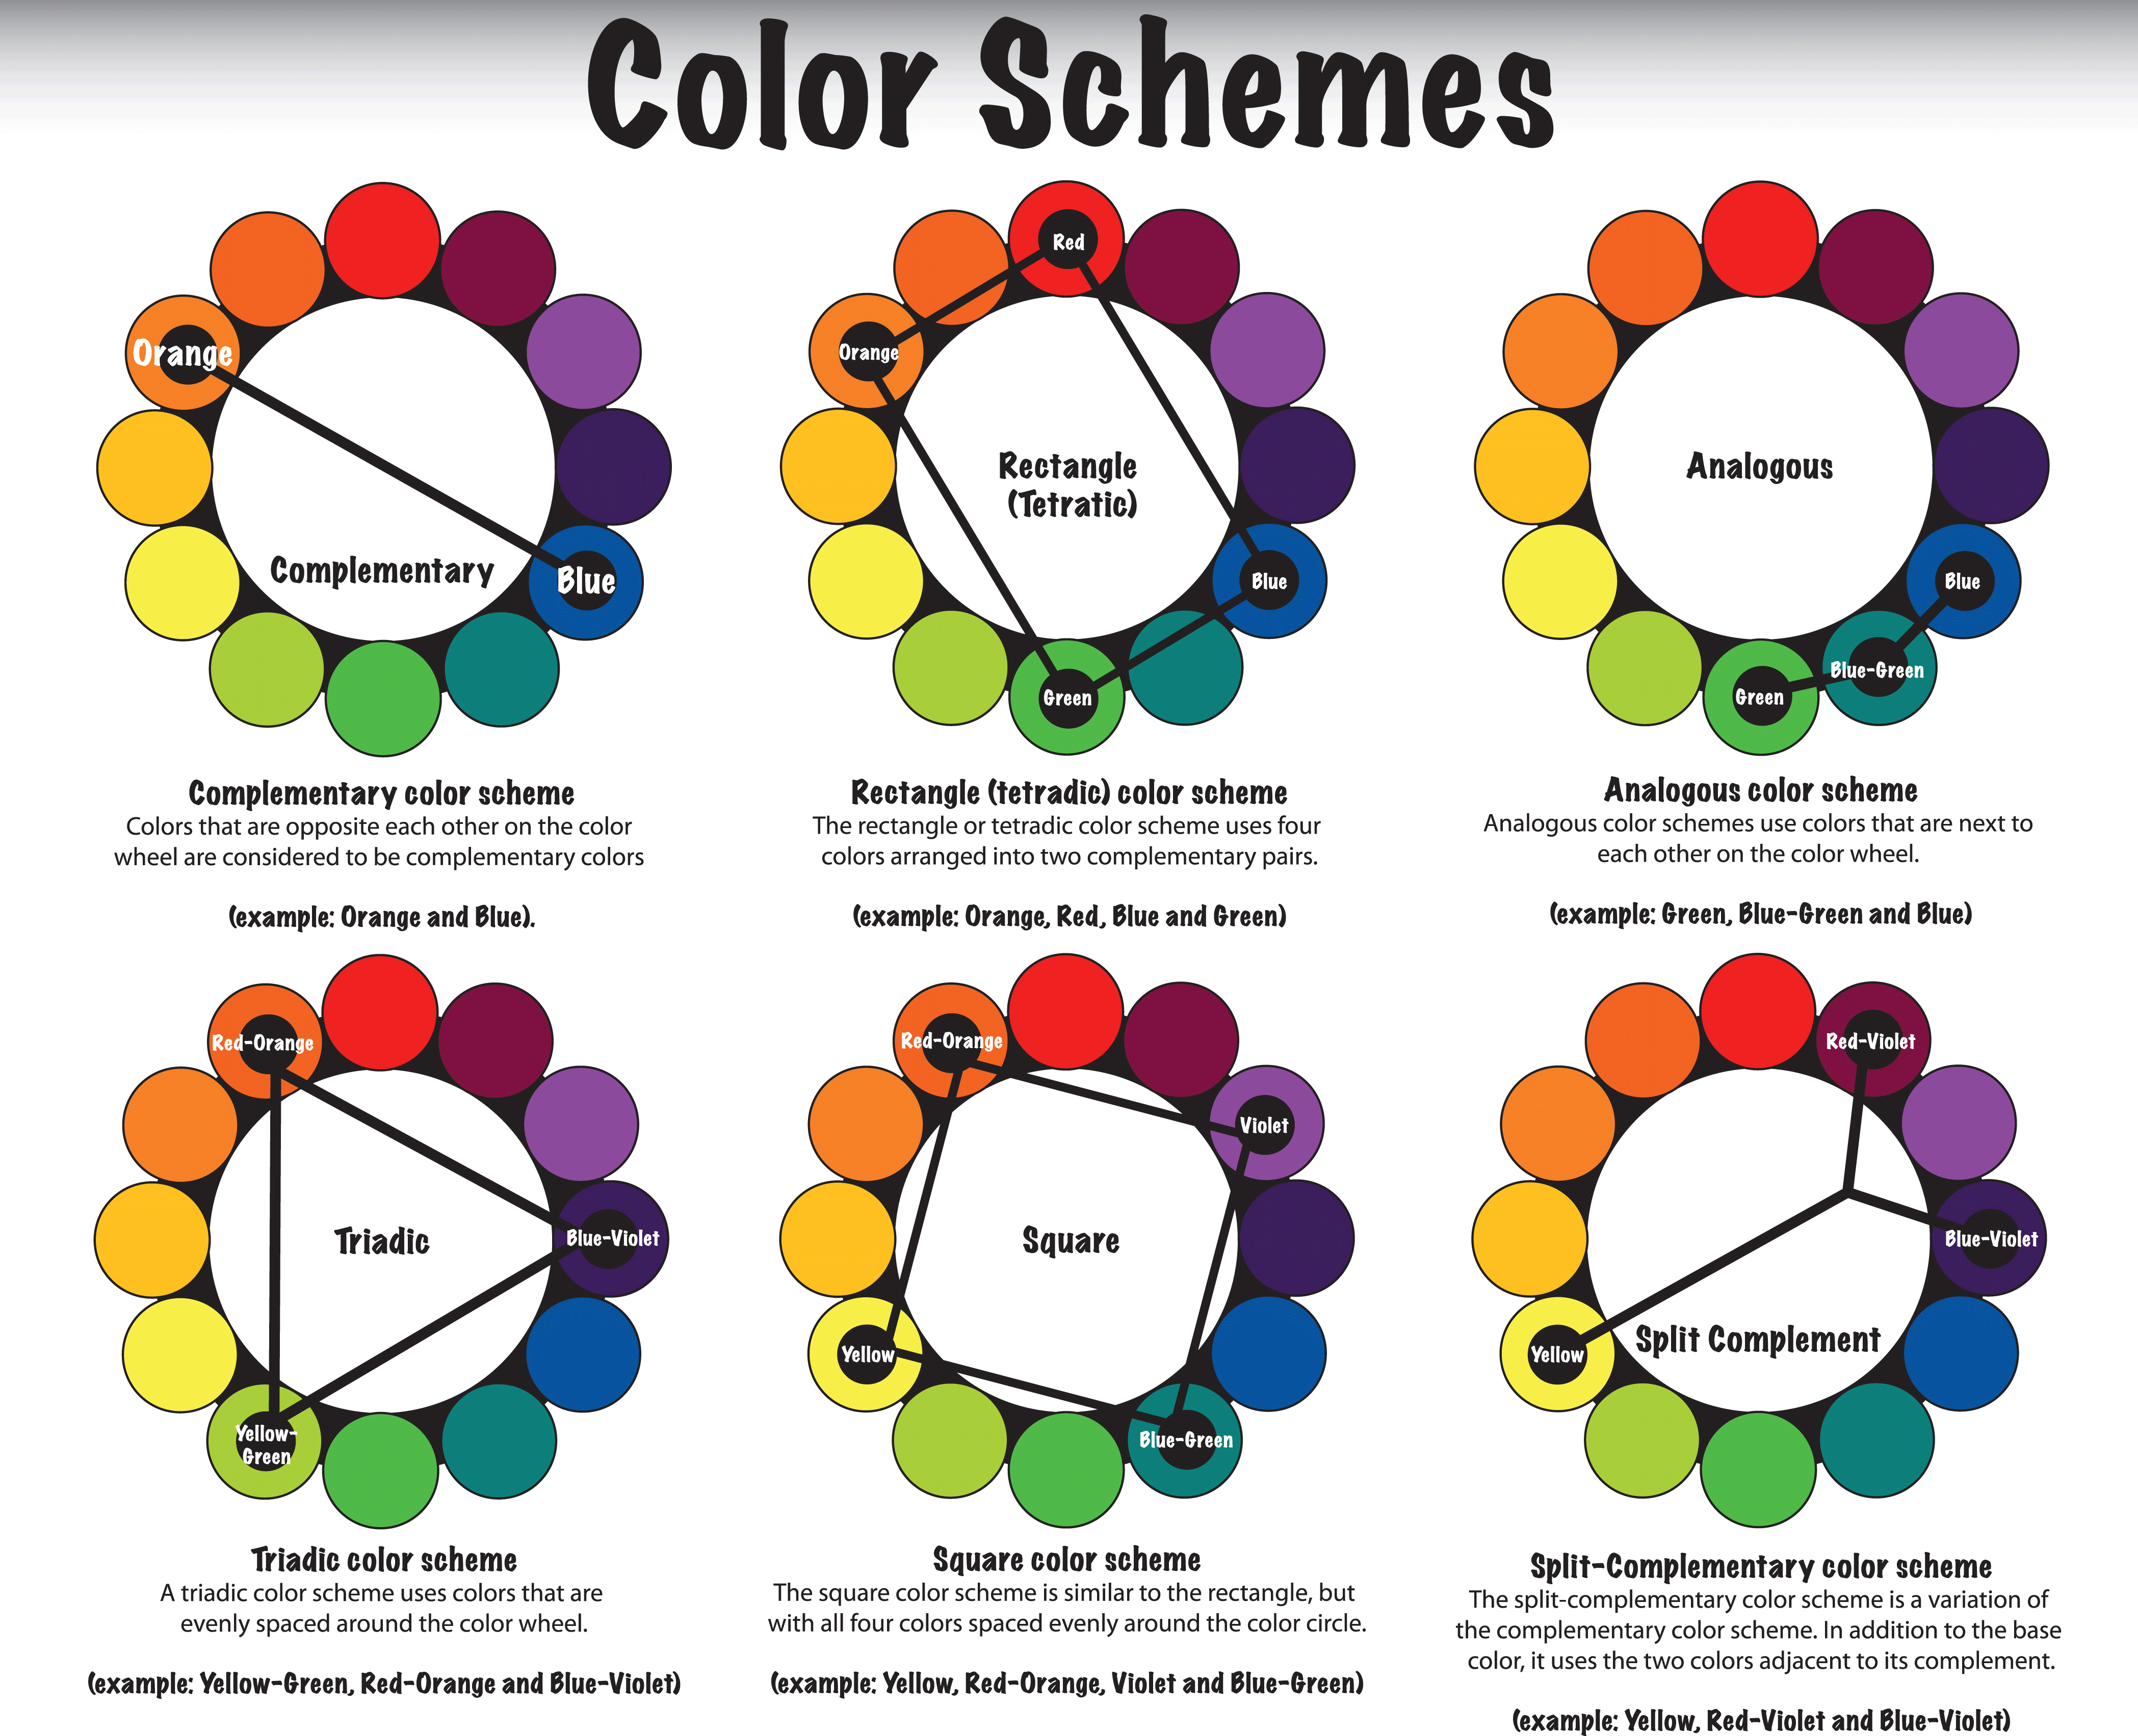

Research
Demographic: Males, 18-24

Slide 5




Research

Slide 6
Our Game

Slide 7
Core Mechanic
Twitch Movement
Aiming the grapple hook
Navigating the environment

Slide 8
What The Player Does
Controls
Axis Movement
Gameplay
Destroy items to increase score
Player with the highest score at the end of the round wins

Slide 9
Prototype

Slide 10
Next Steps…

Slide 11
Feedback/Questions?

Slide 12



